Slide 1
Data Visualization with Dojo toolkit
Gu Yi, He
Apache Asia Roadshow 2010

Slide 2
Agenda
Why JavaScript?
Getting started with Dojo Charting
Dashboards
Drawing with Dojo GFX
Embracing the next new Tech Wave
Further Reading

Slide 3
Why JavaScript?
Rich Internet Applications
  Flex
  Silverlight
  JavaFX
  JavaScript/CSS/HTML

Slide 4
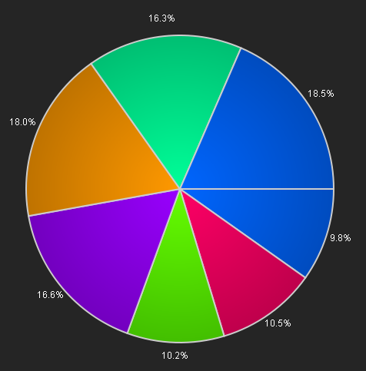
Getting Started with Dojo Charting
Our first Pie chart
IE / Firefox / Safari / Chrome compatible!

Slide 5
Getting Started with Dojo Charting
Easy to create
  Requiring Charting Classes
  Two ways to play
    Declarative Chart Creation
    Programmatic Chart Creation
  Chart Animations, Legends, and Themes

Slide 6
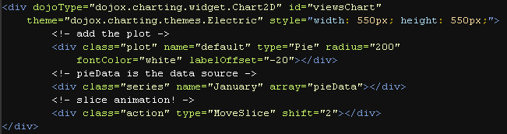
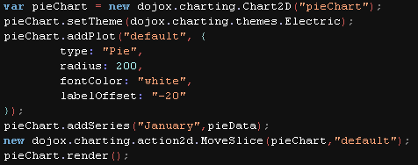
Getting Started with Dojo Charting
Declarative / Programmatic Chart Creation
Declarative
Programmatic

Slide 7
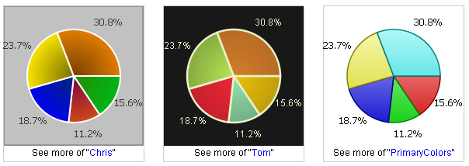
Getting Started with Dojo Charting
Customize the chart
  The effects can be “added” onto the chart like plugins
  We can finely control the behavior and apparence of the chart

Slide 8
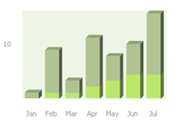
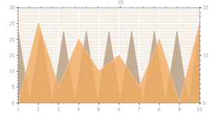
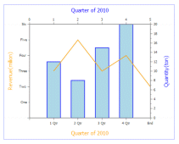
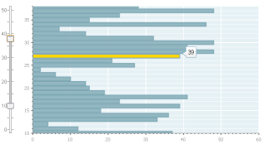
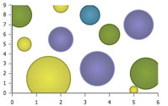
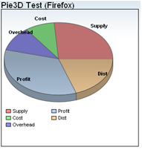
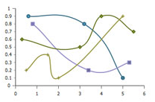
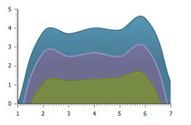
Getting Started with Dojo Charting
Abundant amount of chart types

Slide 9
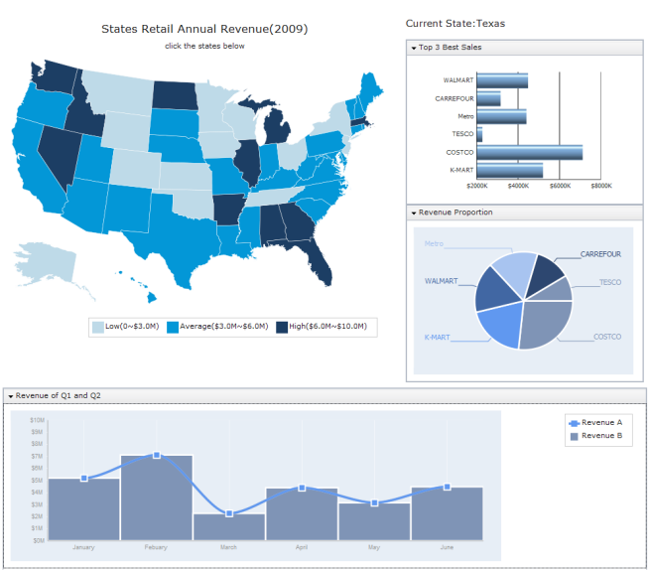
Dashboards

Slide 10
Drawing with Dojo GFX
Need to invent a new chart type?
Need to draw freely?
Dojo GFX is a cross-platform vector graphics API you are looking for
  SVG (Firefox 1.5-3.6, Safari(Webkit) 3.0, Opera 9.0, Chrome(Webkit), iPhone Safari 2.1)
  VML (IE 6-8)
  Silverlight (wherever it is supported by Microsoft)
  Canvas (Firefox 2.0-3.6, Safari 3.0 including iPhone Safari 1.x & 2.x, Opera 9.0)

Slide 11
Drawing with Dojo GFX
Dojo GFX loosely follows SVG as the underlying model.
  Every visual presentation created with Dojo GFX begins by creating a Surface object which will serve as the visual rectangular container for shapes.
  In order to draw on a Surface, you'll need to create Shape objects and attach the shapes to a Surface.
  GFX also has the concept of a Group, which is a pseudo-shape. Groups combine other shapes (which can include other groups), and can be used to apply transformation to a group.

Slide 12
Drawing with Dojo GFX
Supported Shapes
  Rectangle (optionally with rounded corners)
  Circle
  Ellipse
  Line
  Polyline/polygon
  Path (the most versatile shape) Path implements the full SVG path language.
  Image
  Text
  TextPath

Slide 13

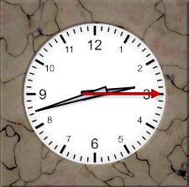
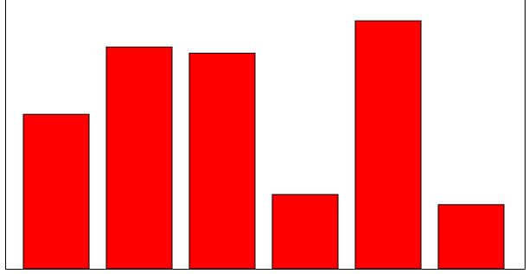
Drawing with Dojo GFX
Demo
Clock
Chart Animation
Dojo guy

Slide 14
Embracing the next new Tech Wave
HTML5 (Canvas)
  Dojo GFX has already adopt canvas as it graph engine.
  Set gfxRenderer=true to force Dojo GFX to use canvas.
Dojo Charting
Dojo GFX
Canvas
SVG
VML
Silverlight

Slide 15





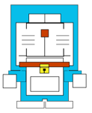

Embracing the next new Tech Wave
CSS3
Doraemon (http://knb.im/css3/)
Safari/Chrome/FireFox 3.6
Opera 10.53
Safari (iPhone OS 3.1)
IE9 beta
IE8
IE7
IE6

Slide 16
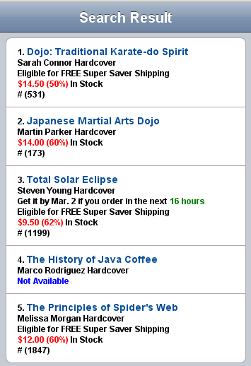
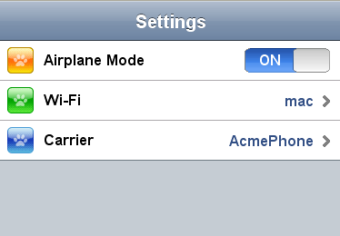
Embracing the next new Tech Wave
Mobile
Switch
List

Slide 17
Further Reading
dojotoolkit.org
  http://dojotoolkit.org
IBM developerWorks
  http://www.ibm.com/developerworks/
Dojo Toolkit SDK

